Slide 1

IT TICKETS SUPPORT SYSTEM ANALYSIS
Parikshith N K
16/10/2024

Slide 2
About the Project
Whenever an employee encounters an issue, he will raise tickets which are resolved by “IT TICKETS SUPPORT TEAM”. This project is all about analyzing the historical data of the support team.
PRIMARY OBJECTIVES:
To improve the efficiency of the team to reach it highest potential.
If investment has to be made where it should be invested ?
Draw insights on top and low performers in the team.

Slide 3
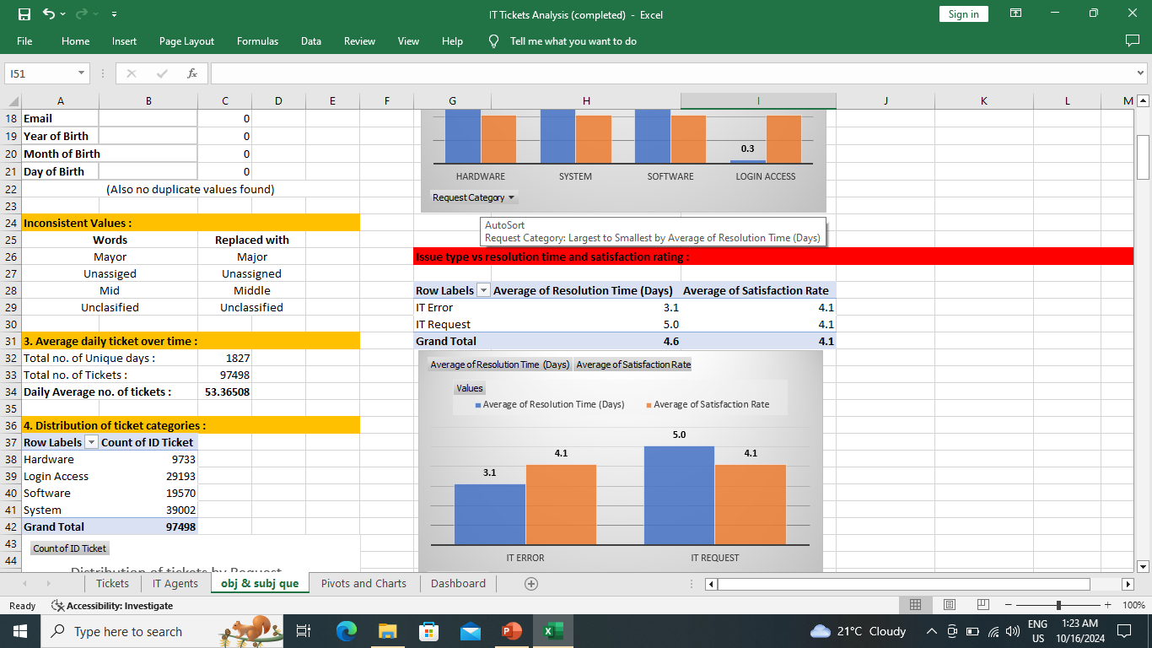
DATA OVERVIEW
Dataset allows for an in-depth analysis of tickets’ satisfaction rating and resolution time and also allows to draw insights about the top and low performing agents.
Dataset includes:
Total number of tickets: 97498
Total number of employees who are raising tickets: 2000
Total number of agents who are resolving tickets: 50
Other data: type of ticket, satisfaction rating, resolution time etc.
Data cleaning and preprocessing:
Every columns are checked for missing values and filled with average or mode appropriately.
Some inconsistent values are replaced as shown in figure.

Slide 4
ANALYTICAL APPROACH AND TOOLS
Data Enrichment: Enhanced the dataset with additional variables using VLOOKUP.
Descriptive Analysis: Employed PivotTables for summarizing key metrics like average resolution time (days) and satisfaction rating of agents.
Trend Analysis: Used line chart to visualize the trend of volume of tickets, average satisfaction rating and average resolution time over years or months or Quarters.
Visualization: Created dynamic Dashboard for data representation along with slicers to enable interactive data exploration.

Slide 5
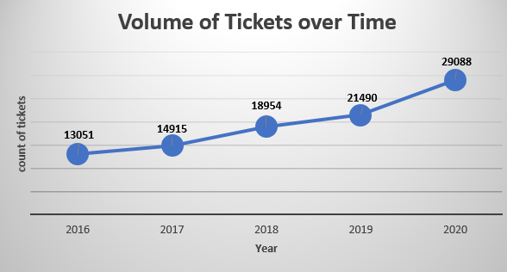
How has the volume of tickets changed over time?
Volume of tickets has increased over time from 2016 to 2020.

Slide 6
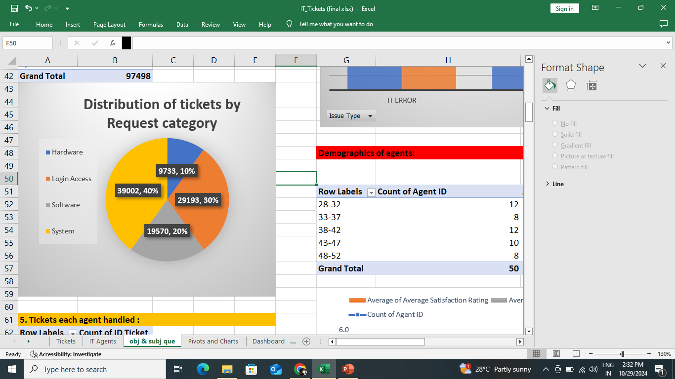
What is the distribution of tickets across categories (e.g., Login Access, System, Software)?
According to analysis, System has highest share of 40% followed by login access, software and then hardware.

Slide 7
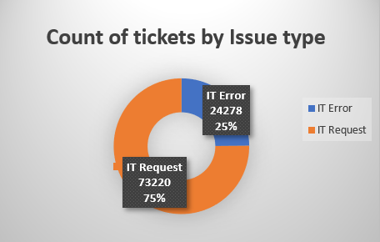
What is the count of each issue type (e.g., IT Error, IT Request)?
Count of IT Error and IT Request are 24278 and 73220 respectively.

Slide 8
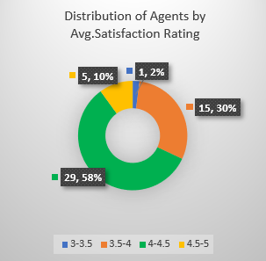
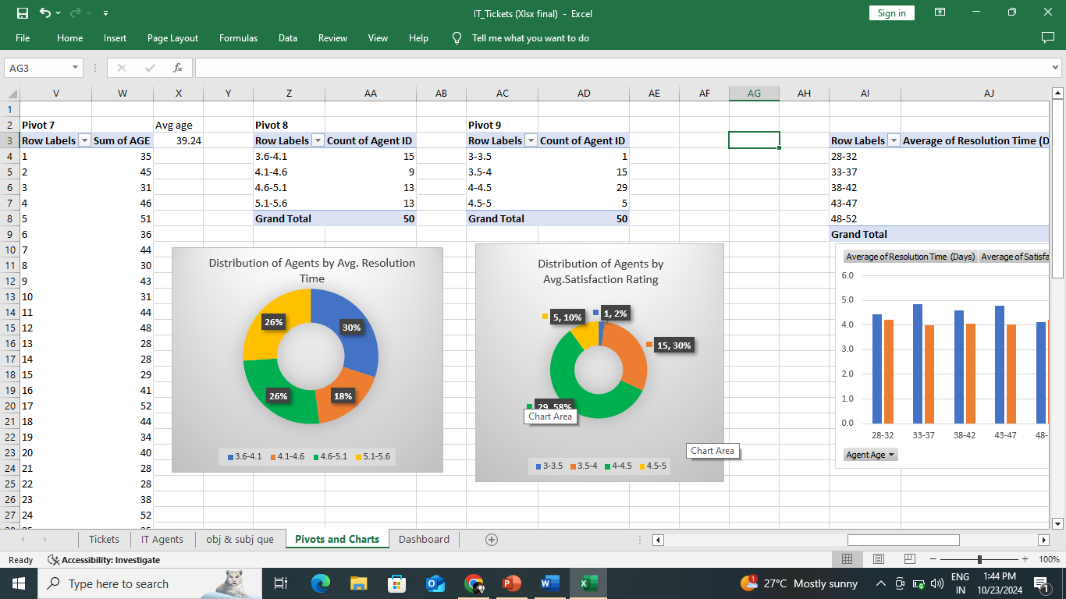
Which agents need additional training based on their performance metrics?

Slide 9
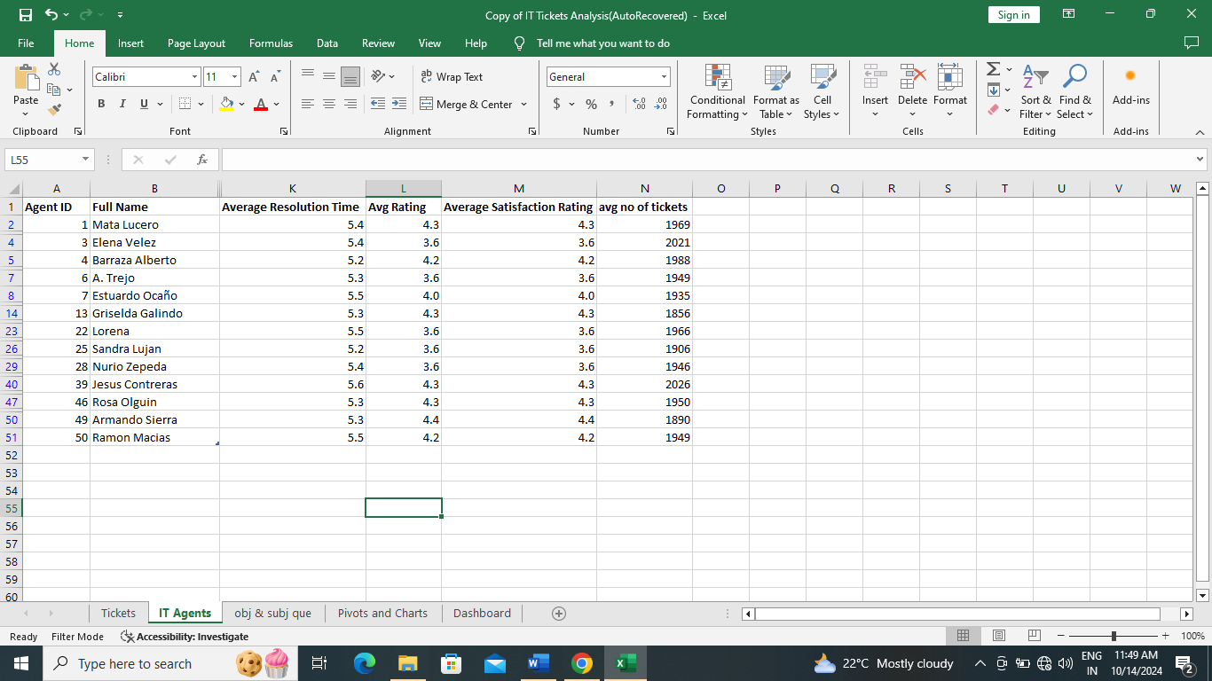
Who are those agents with highest resolution time and needs training ?
Highest band for average resolution time(days) is 5.1-5.6 days. So these agents must be trained in first priority if we are going by average resolution time.

Slide 10
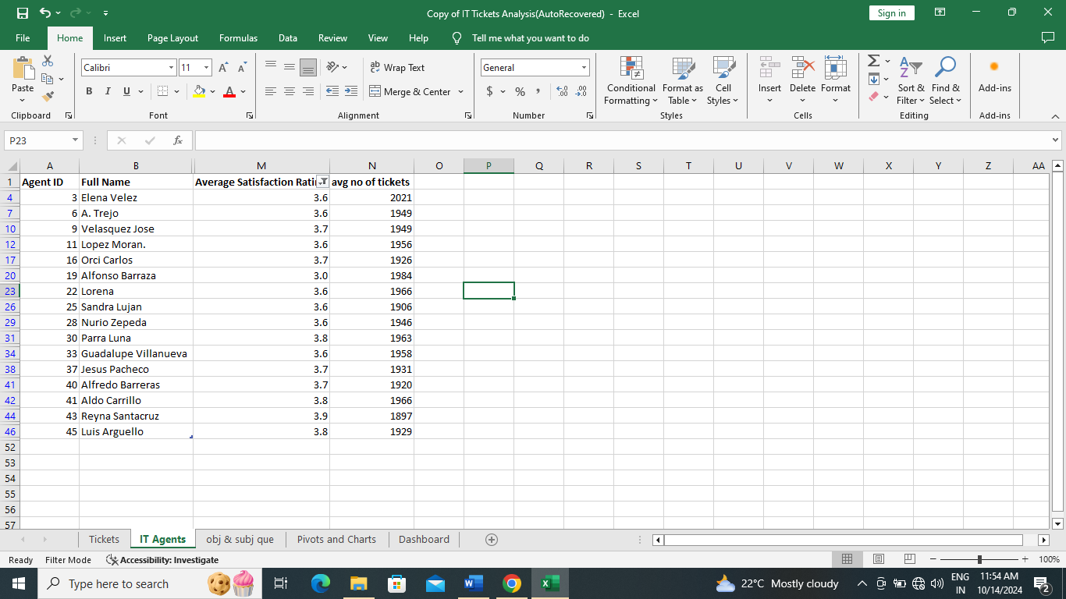
Who are those agents with lowest satisfaction rating and needs training ?
Lowest band for satisfaction rating is 3-4. So these agents must be trained in first priority if we are going by average satisfaction rating.

Slide 11
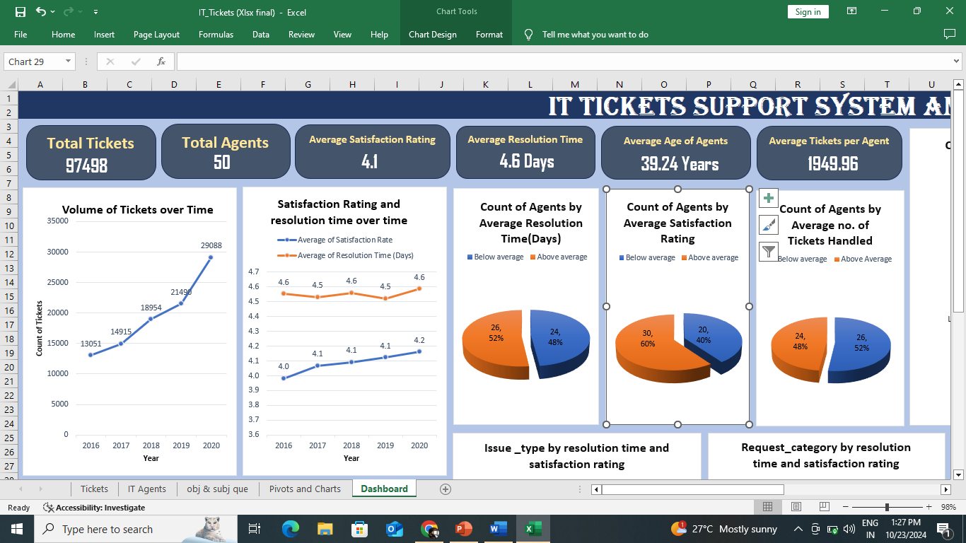
How effective are the current software tools in managing IT tickets?
Insights from Data:
The Current software tools have performed good. From the first graph it is evident that there is a surge in number of tickets, but our system has handled it better despite a slight increase in resolution time. Increase in average satisfaction rate is commendable.
Recommendation:
Training, hiring or upgrading software tools are solutions in first, second and third priority respectively.

Slide 12
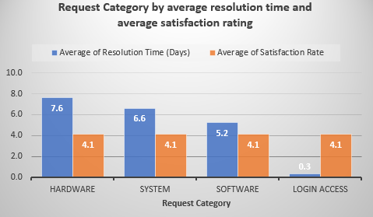
If we invest more on tech (Hardware, software, etc) do you think it will improve the ticket resolution times and employee satisfaction?
Data Insights:
1. 30% of volume of tickets belong to hardware and Software.
2. Resolution time for hardware is highest (7.6 days) and for software (5.2 days) also it is high (though it is comparatively less than system (6.2 days) and hardware).
3. Satisfaction rate is almost stagnant and same for all categories of requests.

Slide 13
Where should investment must be done then ?
Recommendation:
Yes, investment in ‘hardware’ and ‘software’ will improve employee satisfaction rate and reduce resolution time. But ‘System’ request category has more resolution time than software, so investing in ‘hardware’ and ‘system’ would be best option than hardware and software.

Slide 14
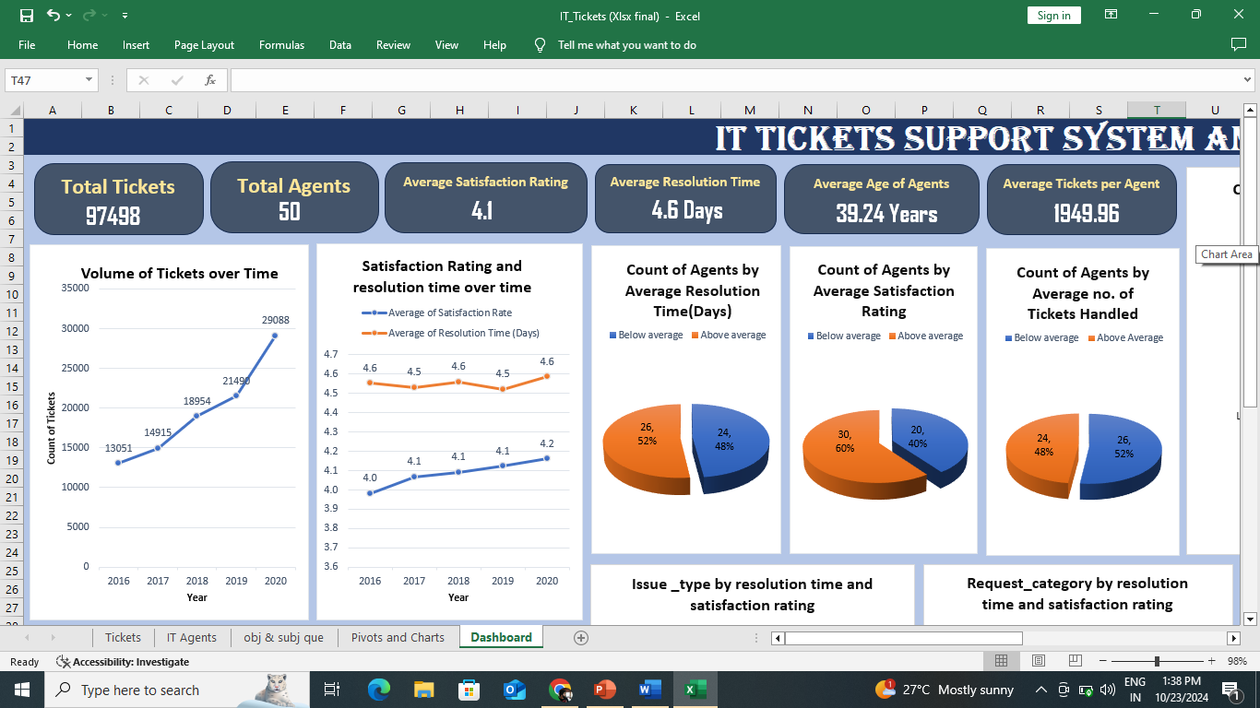
STRATEGIC RECOMMENDATIONS
If there is an investment, should it be used to hire more IT agents, improve training programs, or upgrade ticket management software?

Slide 15
STRATEGIC RECOMMENDATIONS (Cont..)
Data Insights: (From last figure)
1. 48% (24) of Agents are below average (4.6 days), if Resolution time(days) is considered.
2. 40% (20) of Agents are below average (4.1), if Satisfaction Rating is considered.
3. 52% (26) of Agents are below average (1949 tickets per agent), if tickets handled per agent is considered.

Slide 16
STRATEGIC RECOMMENDATIONS (Cont..)
Recommendations:
1. First priority for investment is Training: As seen from data, IT support team is not performing at its full potential. There is an ample room for training. Benefit: It needs less investment compared to hiring and implementing new tools. Cost: Victimization of agents has to be prevented.
2. Second priority for investment is Hiring: Benefit: It may further increase the satisfaction rating and reduce resolution time also. Team can handle further increase of tickets volume. Cost: More investment needs for onboarding a new Employee and still Team may not work at its full potential.
3. Third priority for investment is upgrade Ticket management software: Benefit: It will be an asset for the Team and can handle future issues like surge of tickets. Cost: Huge investment burden.

Slide 17
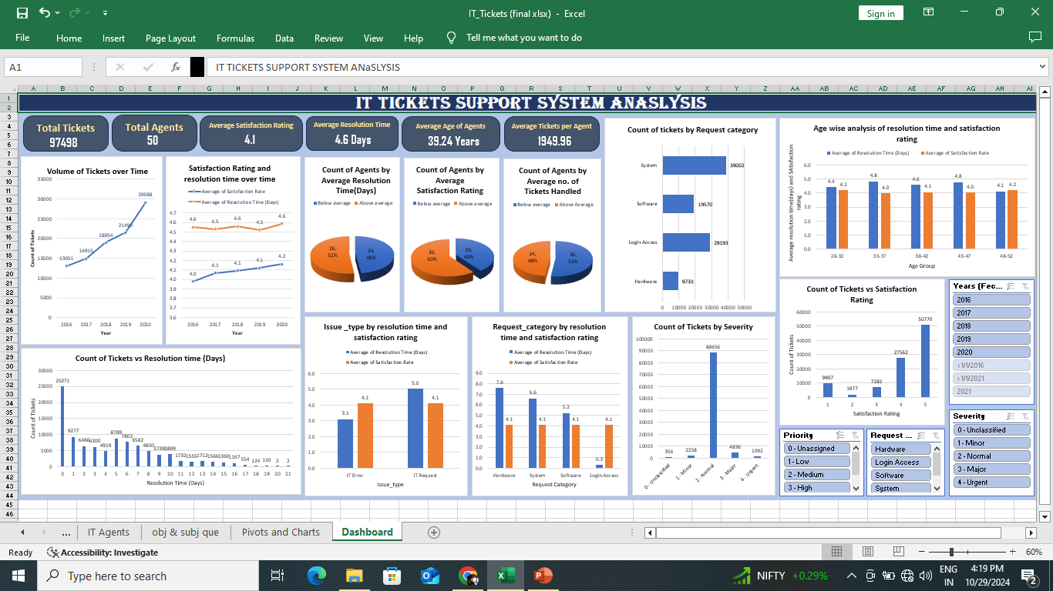
DASHBOARD

Slide 18
DASHBOARD HIGHLIGHTS
It clearly gives insights about the performance of agents like the percentage of them below or above average.
It shows the trend of volume of tickets and performance of the team in terms of satisfaction rating and resolution time over time.
It highlights the distribution of tickets across different request categories and issue types and also respective average satisfaction rating and resolution time.
It gives clear picture of distribution of agents into different bands of resolution time and satisfaction rating.
It has three slicers namely severity, priority and year to enable interactive data exploration for the higher management.

Slide 19
CONCLUSION
Analysis of past data of the team clearly highlighted that the support team is not at its full potential.
It empowers decision makers to decide where to invest, that is to train the below average agents.
My comprehensive analysis of this data paves the way to improve the efficiency of the support team, reduce resolution time of tickets and also enhance employee satisfaction. It also streamlines investments into right direction which can further improve capital-output ratio of entire company.

Slide 20

Thank you

